Slide 1

Artificial Intelligence Lecture 5

Slide 2
KNN
Data Splitting
The slides are credited to Andreas C. Müller

Slide 3
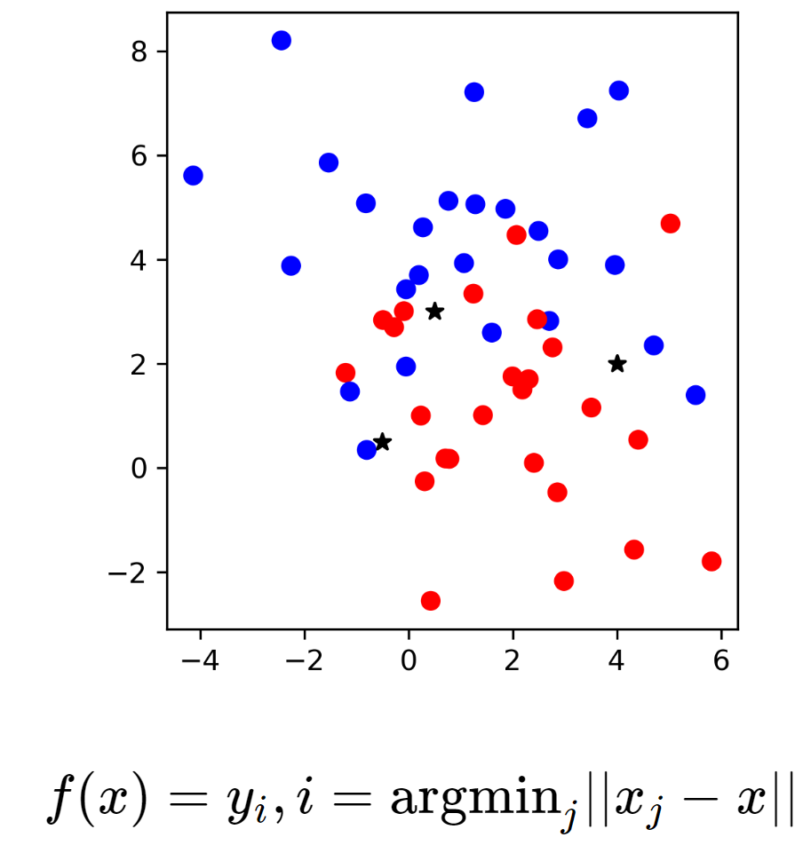
Nearest Neighbors

Slide 4
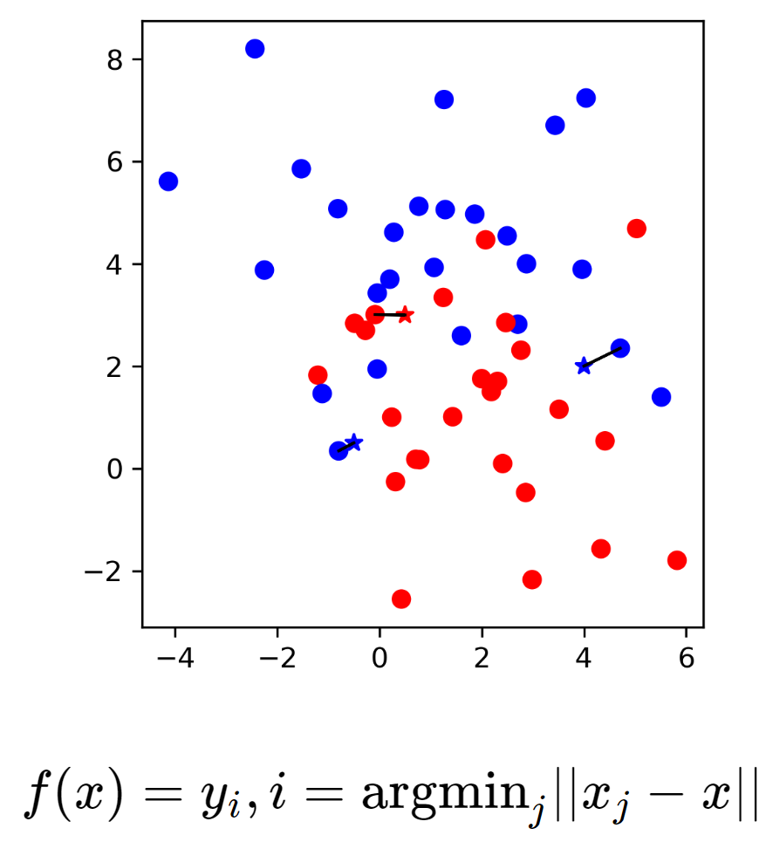

Slide 5
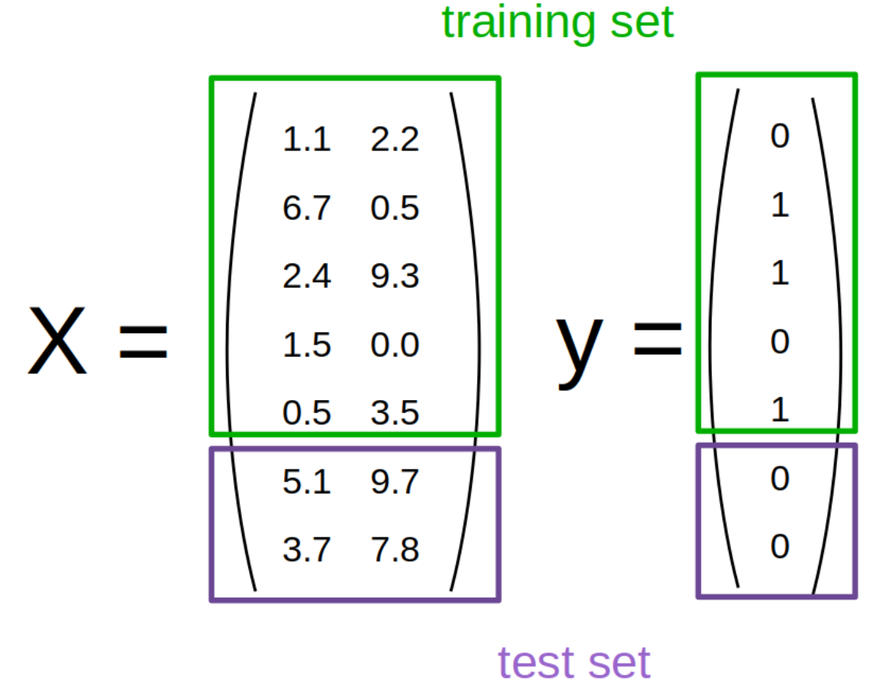

Slide 6
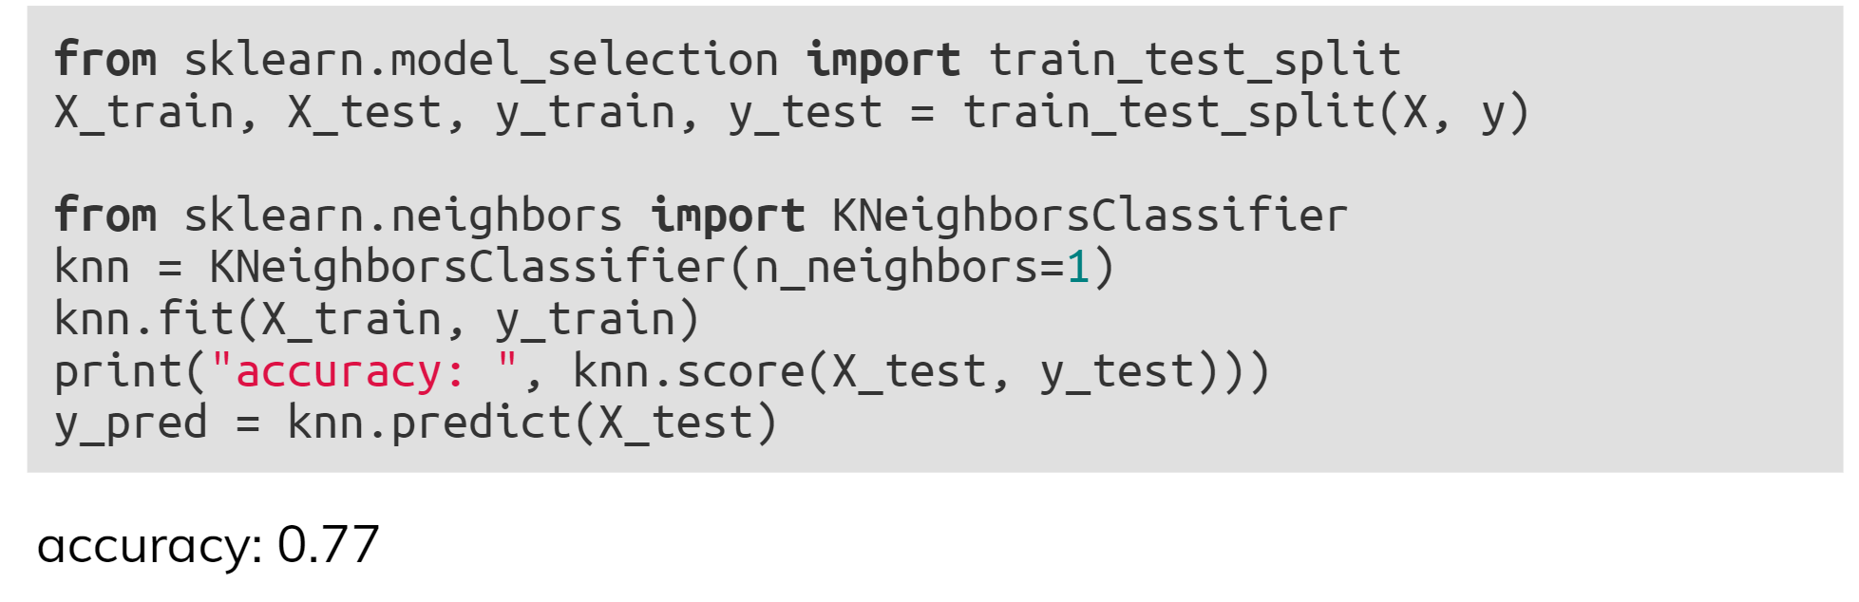
KNN with scikit-learn

Slide 7
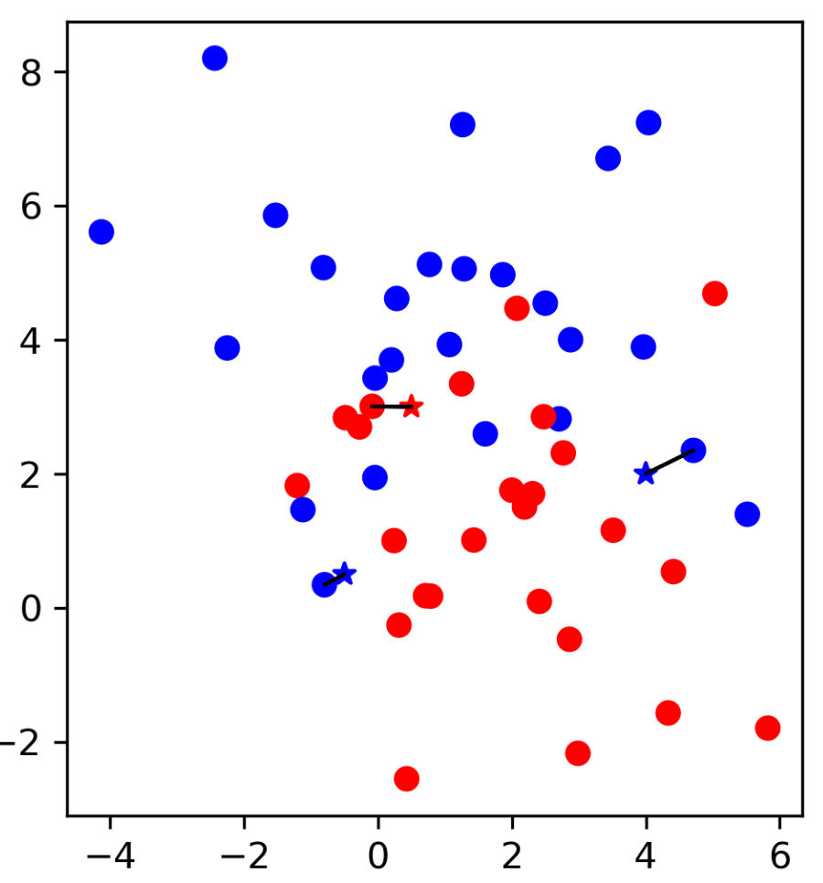
Influence of Number of Neighbors

Slide 8
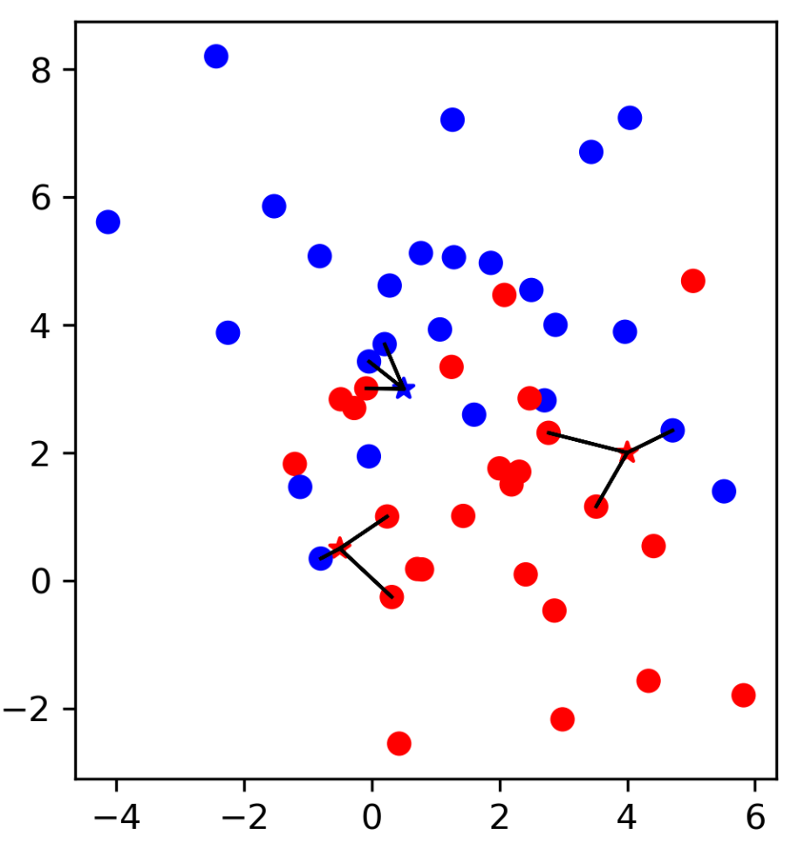
Influence of Number of Neighbors

Slide 9
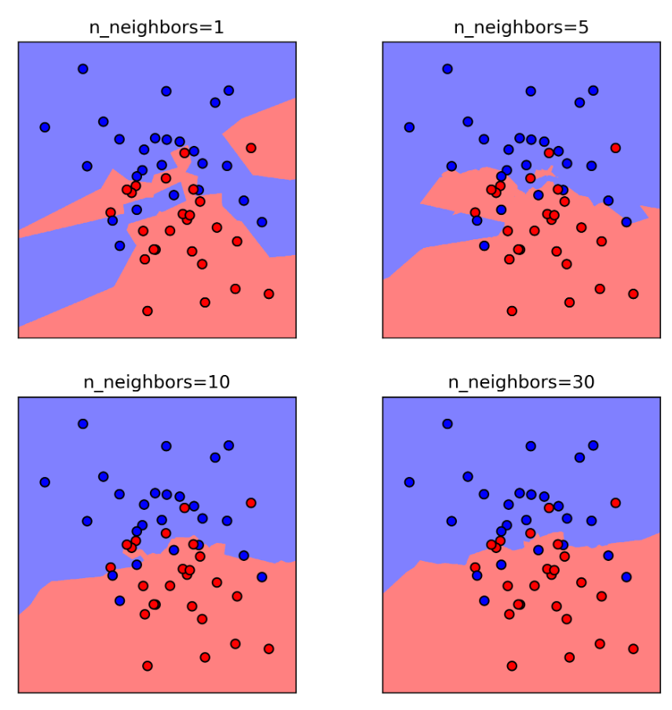
Influence of Number of Neighbors

Slide 10
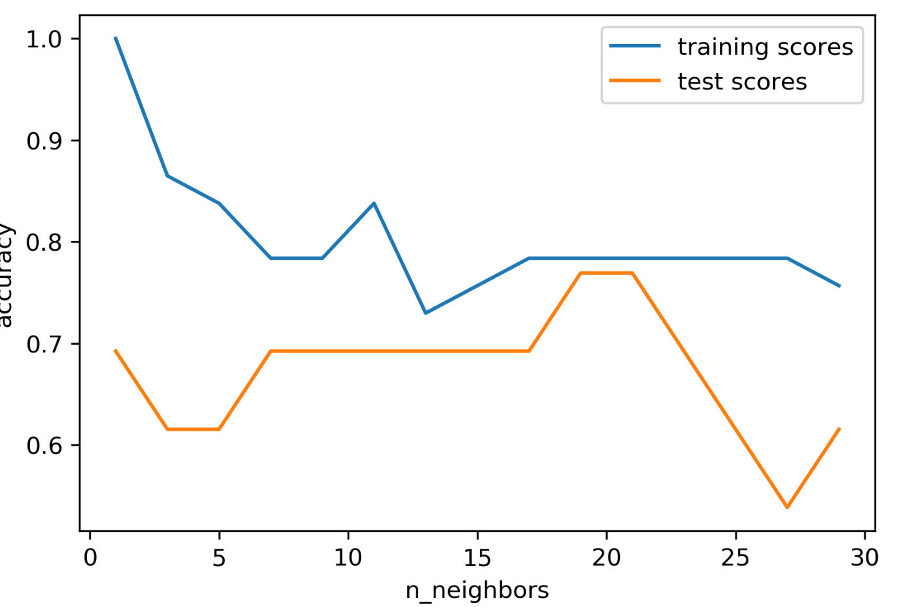
Model complexity

Slide 11
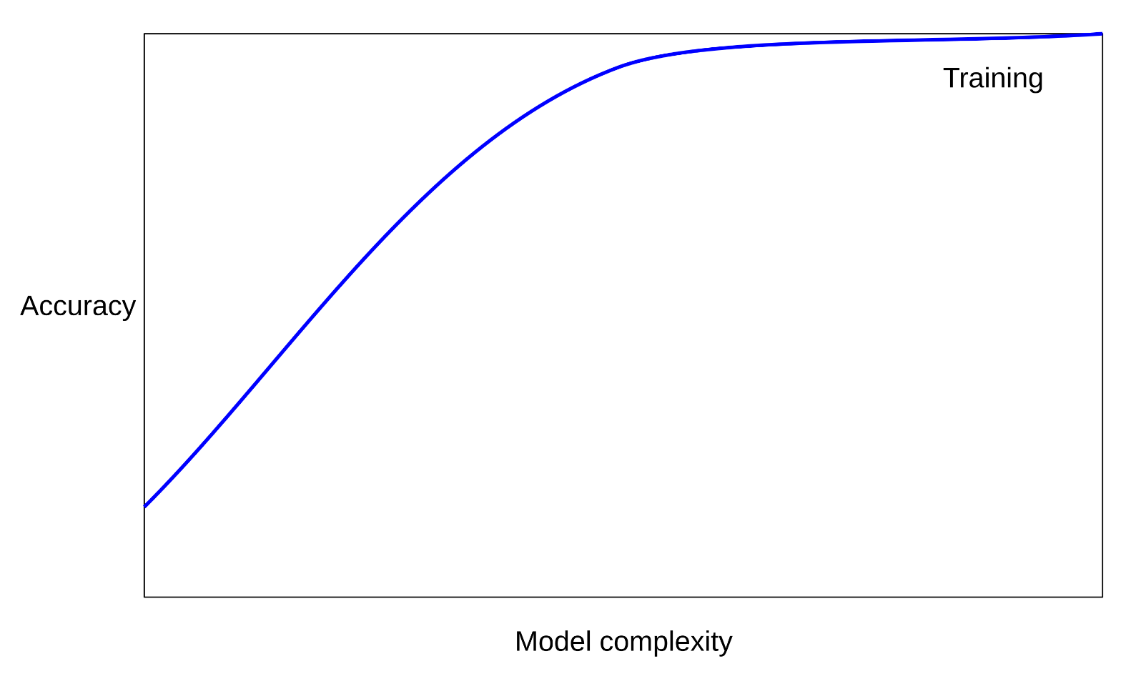
Overfitting and Underfitting

Slide 12
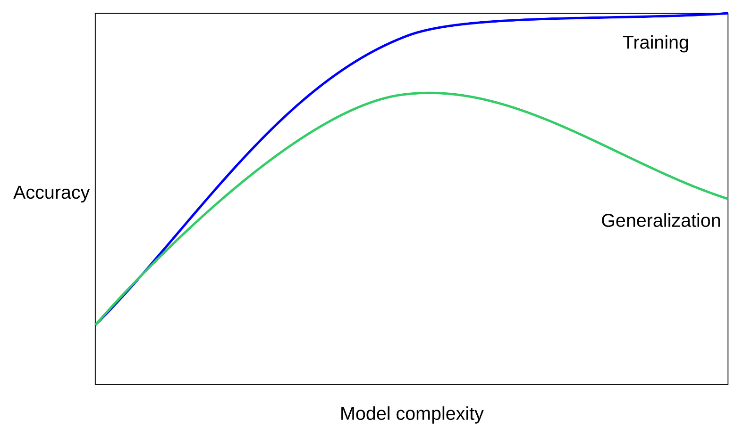
Overfitting and Underfitting

Slide 13
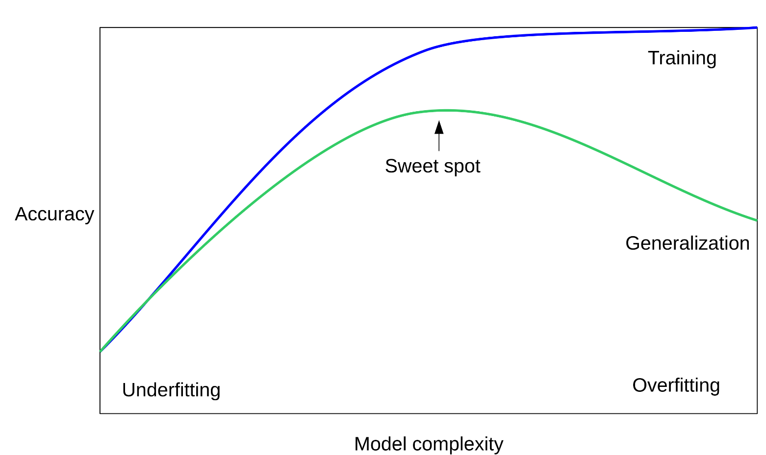
Overfitting and Underfitting

Slide 14
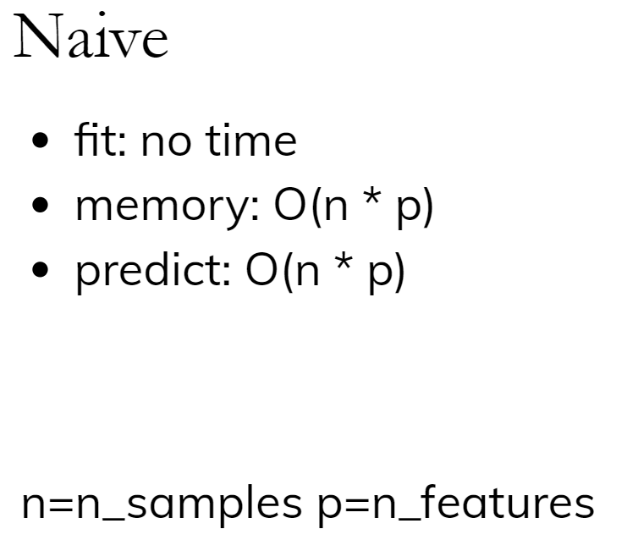
Computational Properties

Slide 15
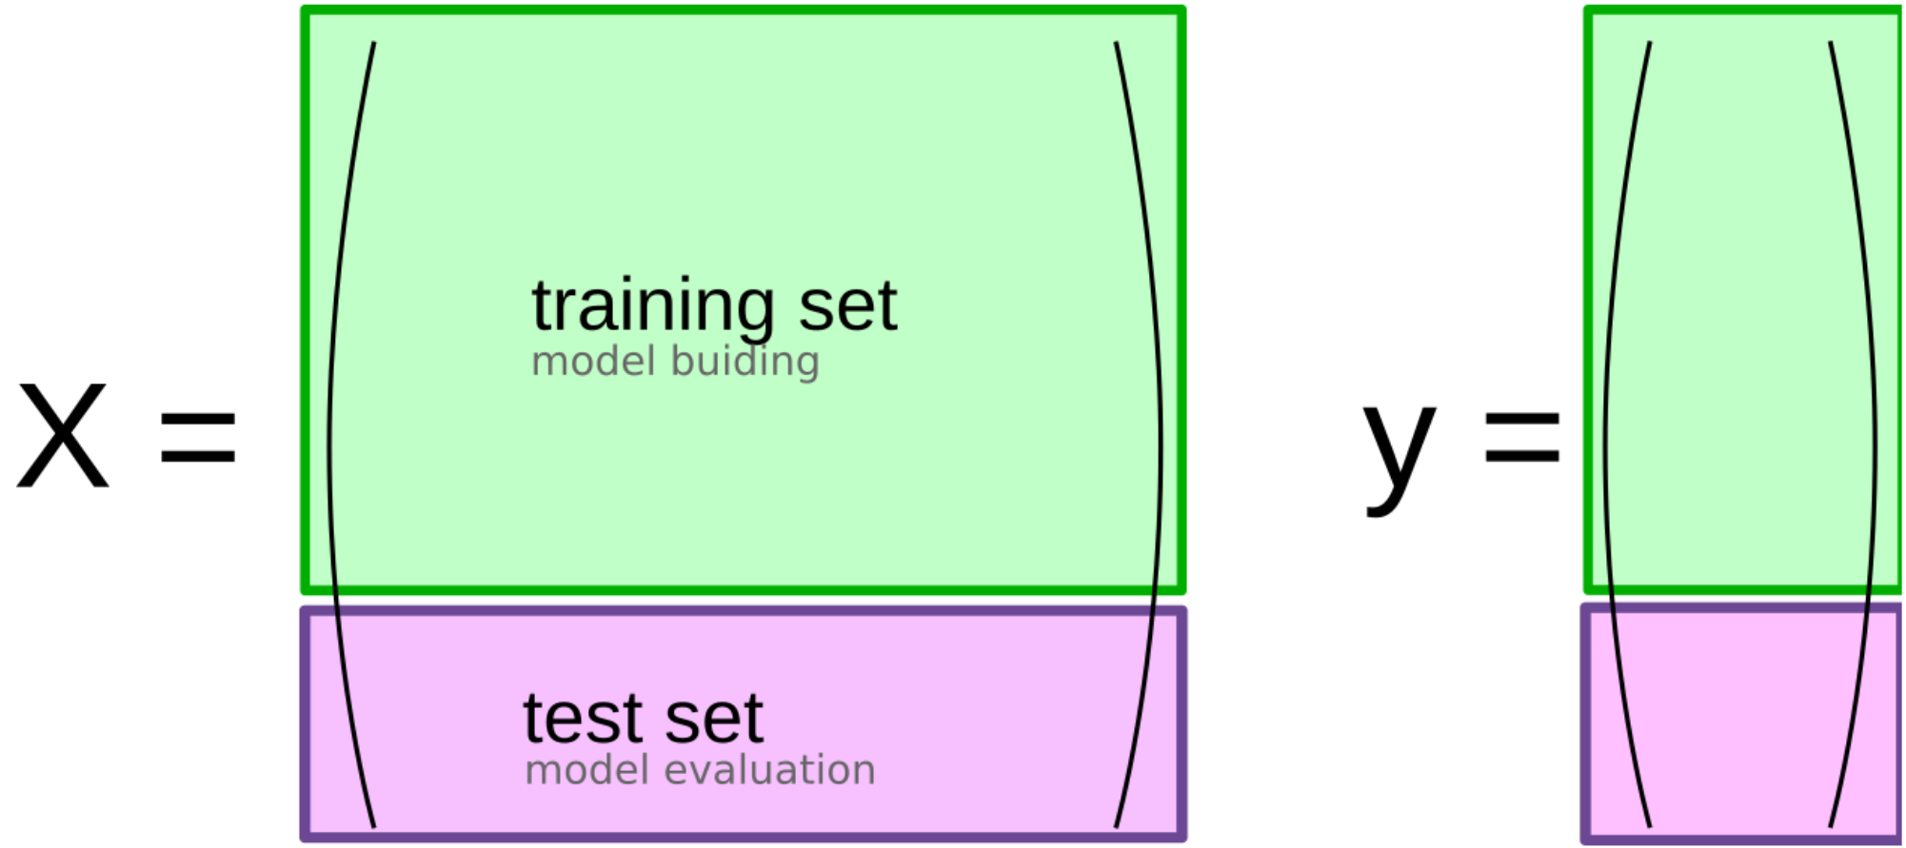
So far: Train-test-split

Slide 16
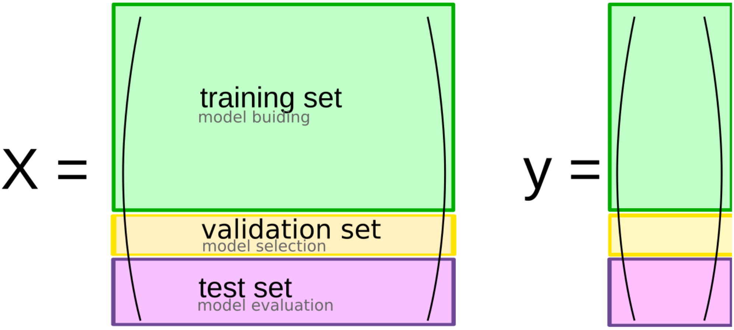
Threefold split
The simplest way to combat this overfitting to the test set is by using a three-fold split of the data, into a training, a validation and a test set.
We use the training set for model building, the validation set for parameter selection and the test set for a final evaluation of the model.
So how many models should you try out on the test set?
Only one!
What are downsides of this?
We lose a lot of data for evaluation, and the results depend on the particular sampling.

Slide 17
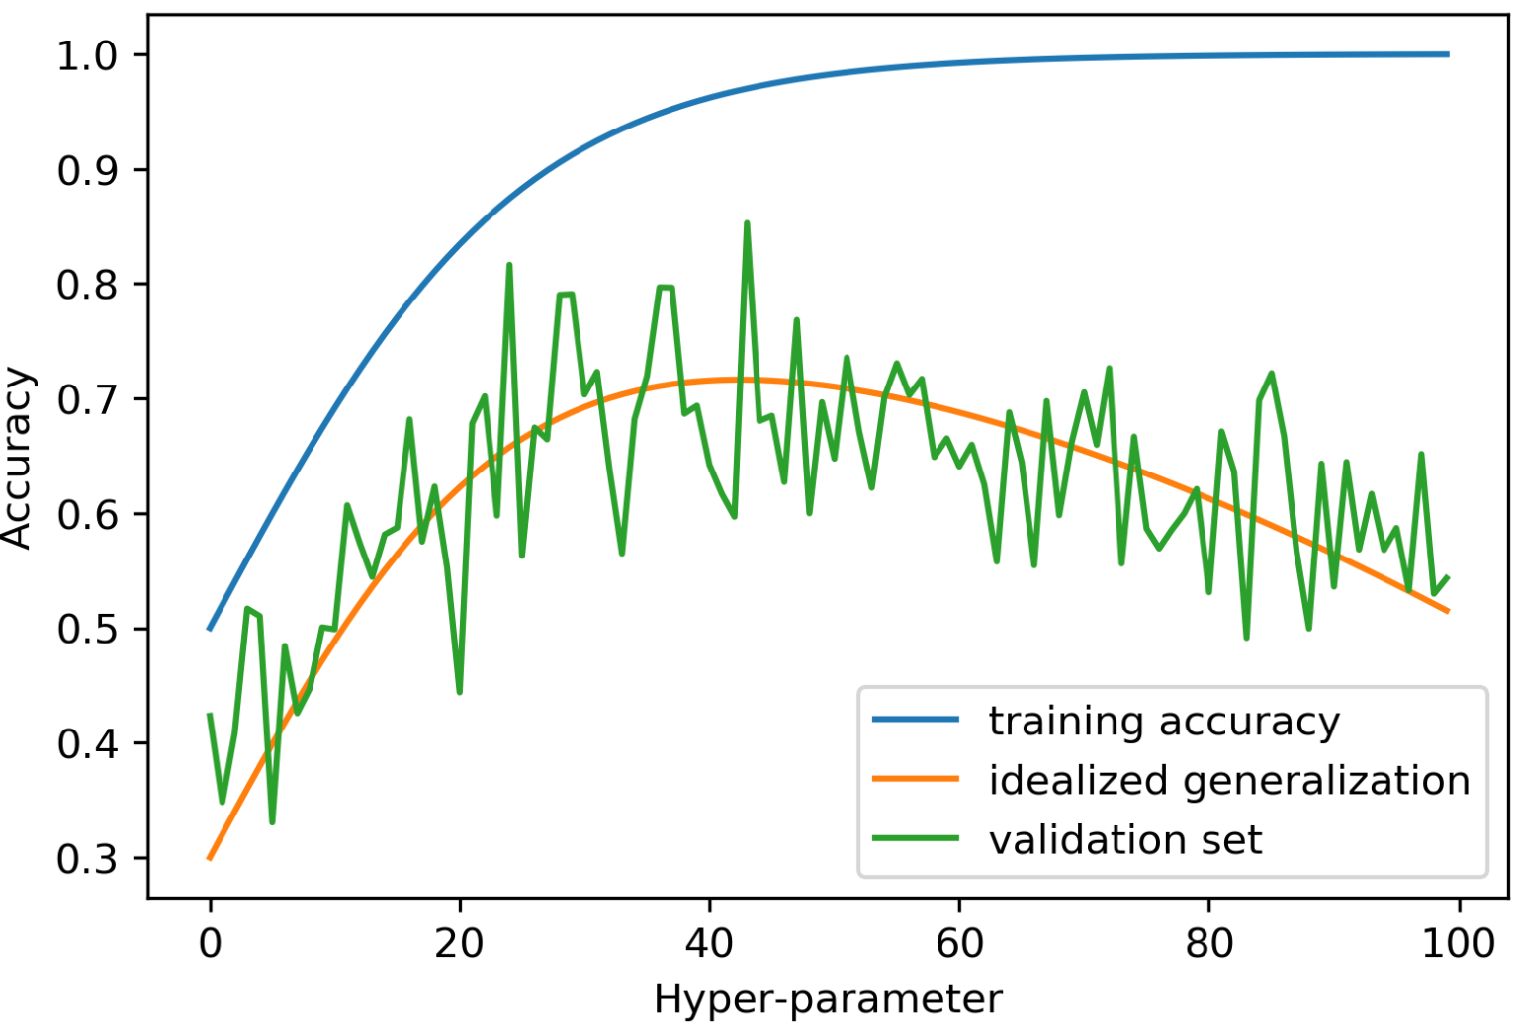
Overfitting the validation set

Slide 18
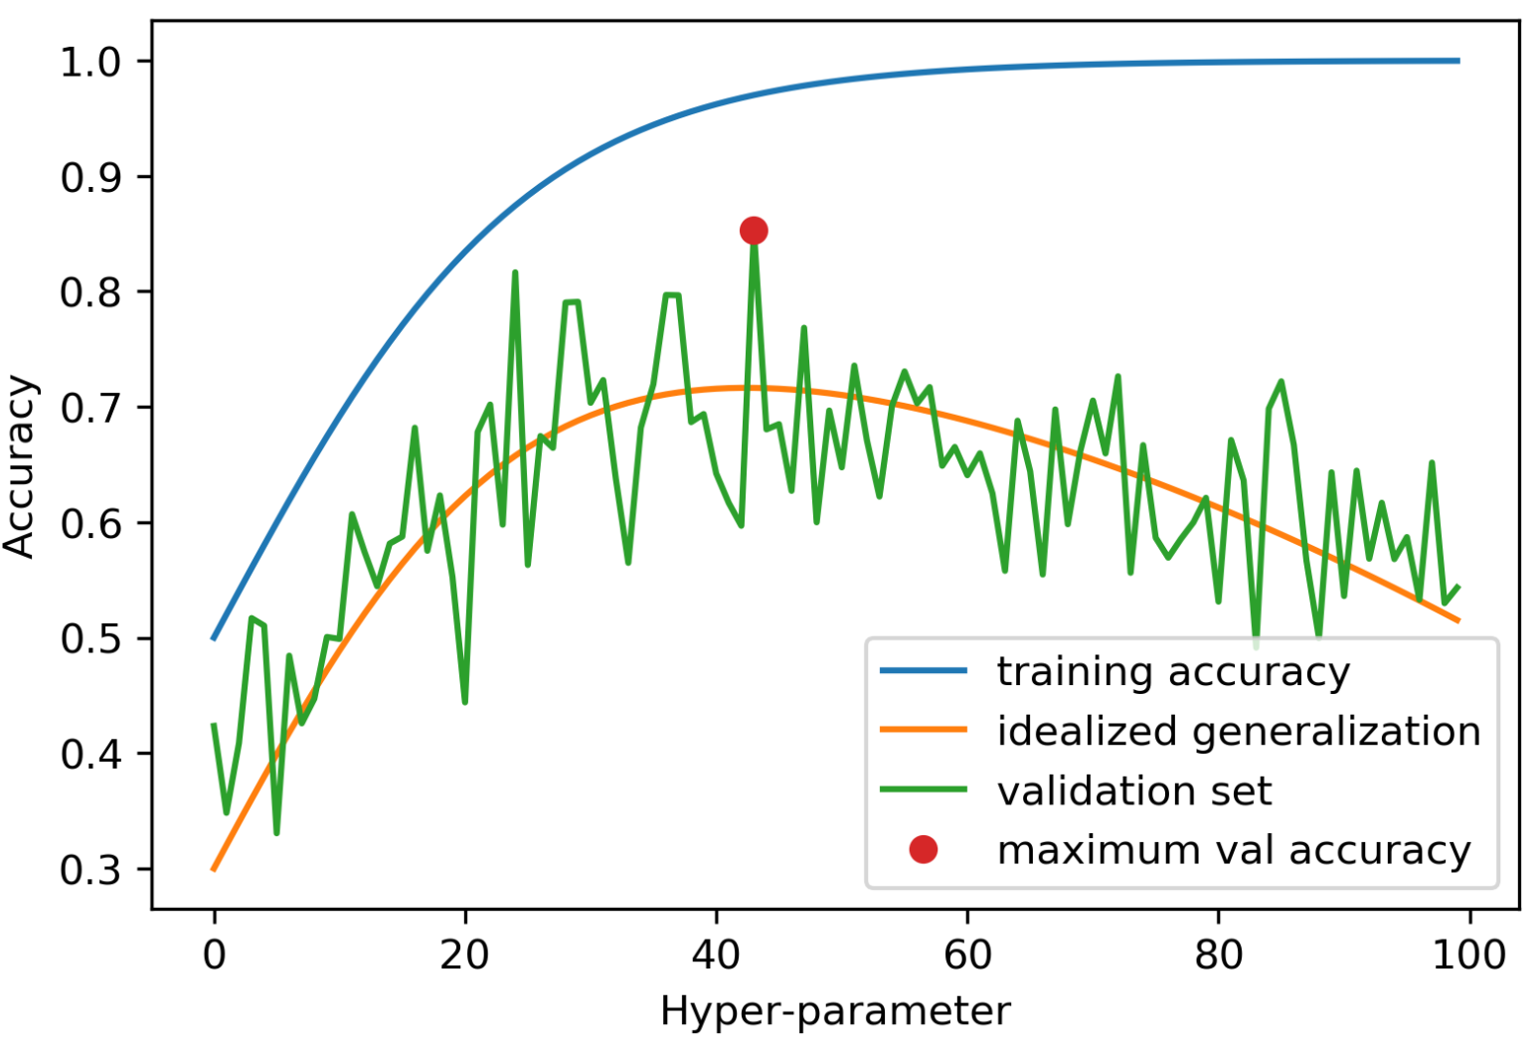
Overfitting the validation set

Slide 19
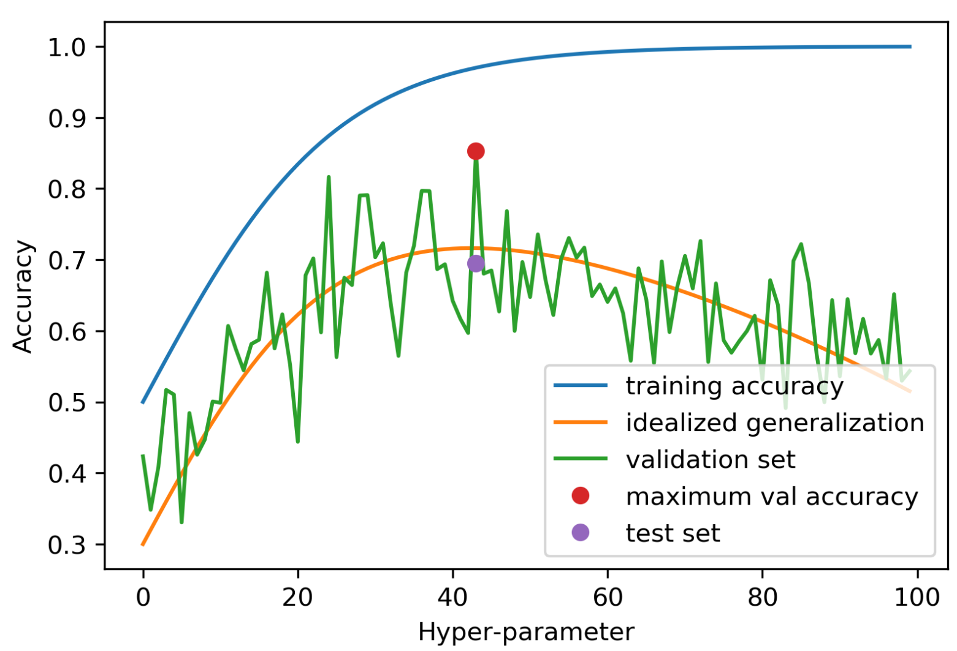
Overfitting the validation set

Slide 20
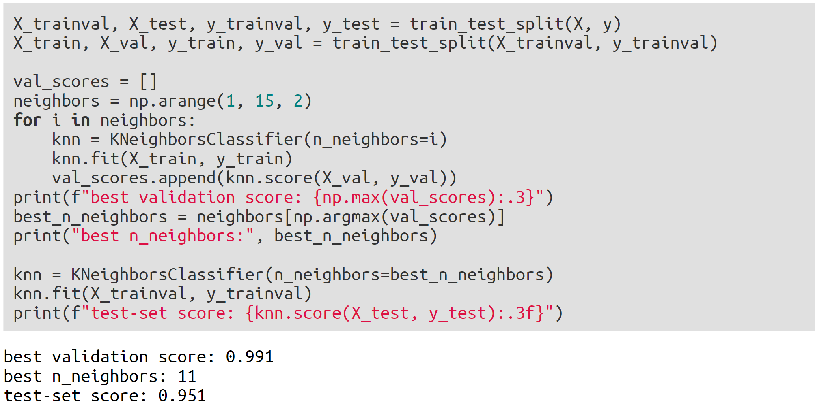
Threefold Split for Hyper-Parameters

Slide 21
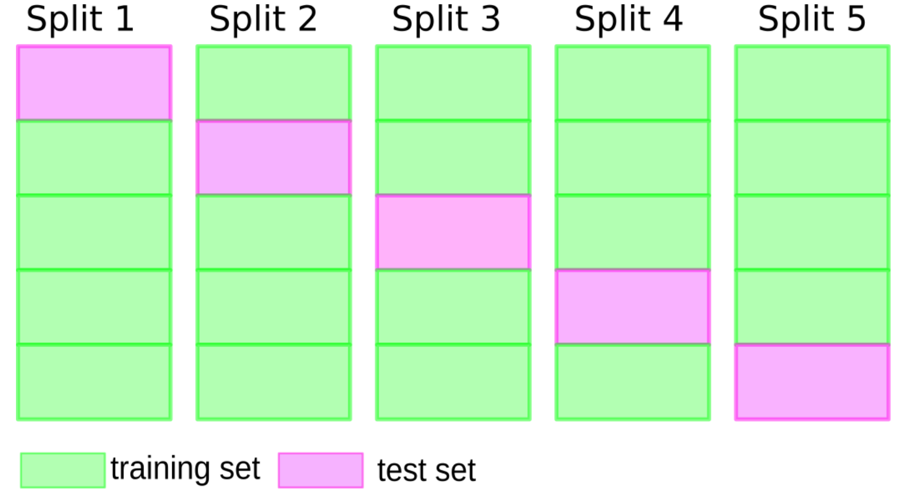
Cross-validation
pros: more stable, more data
cons: slower

Slide 22
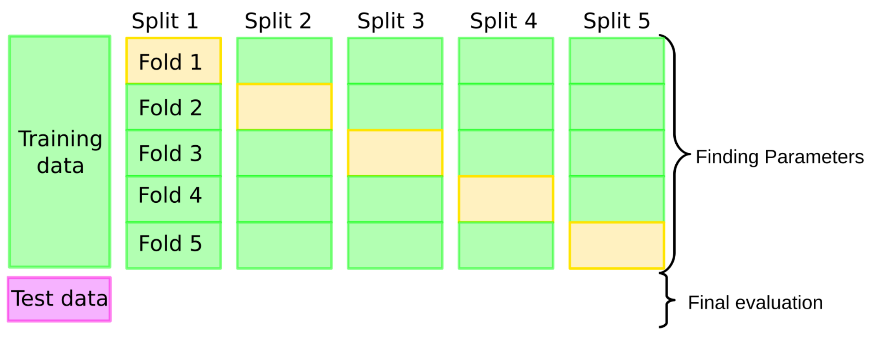
Cross-validation + test set

Slide 23
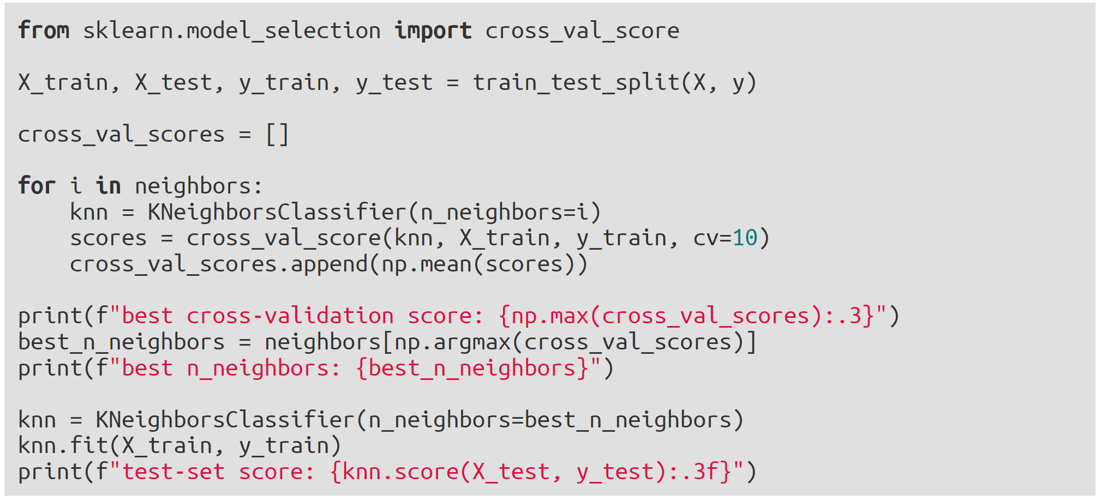
Grid-Search with Cross-Validation
best cross-validation score: 0.967
best n_neighbors: 9
test-set score: 0.965

Slide 24
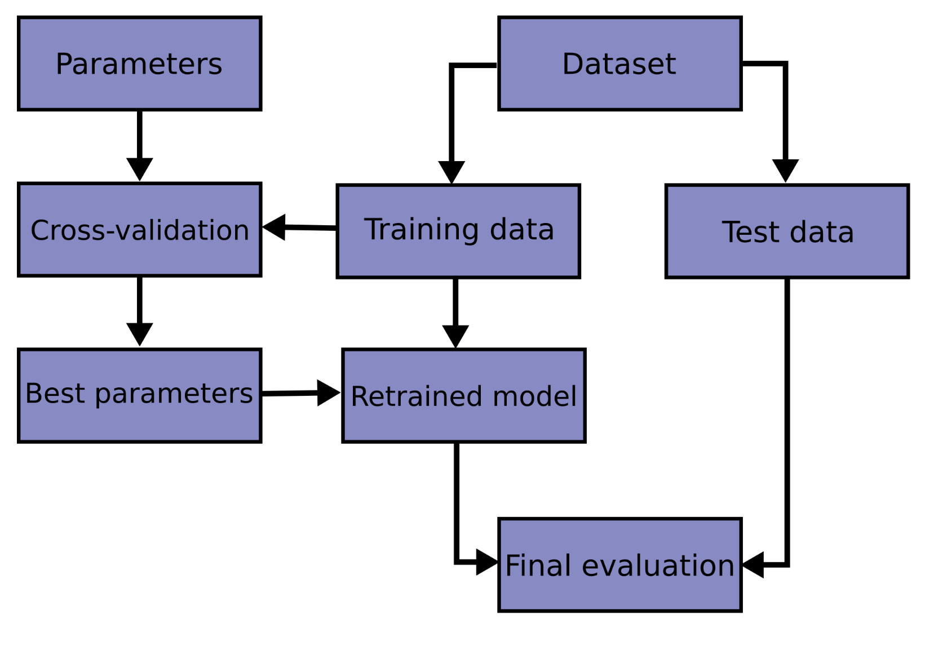

Slide 25
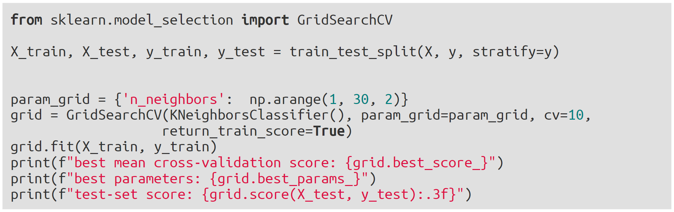
GridSearchCV
best mean cross-validation score: 0.967
best parameters: {'n_neighbors': 9}
test-set score: 0.993

Slide 26
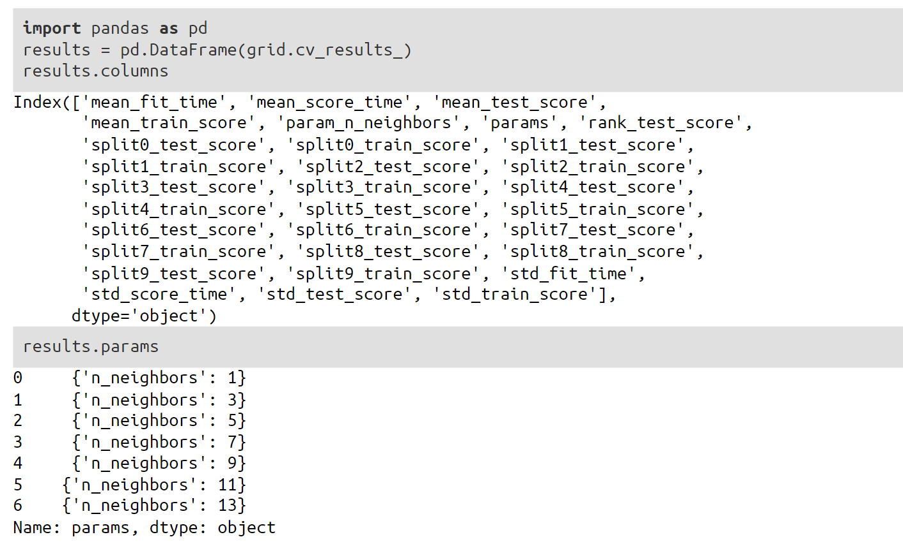
GridSearchCV Results

Slide 27
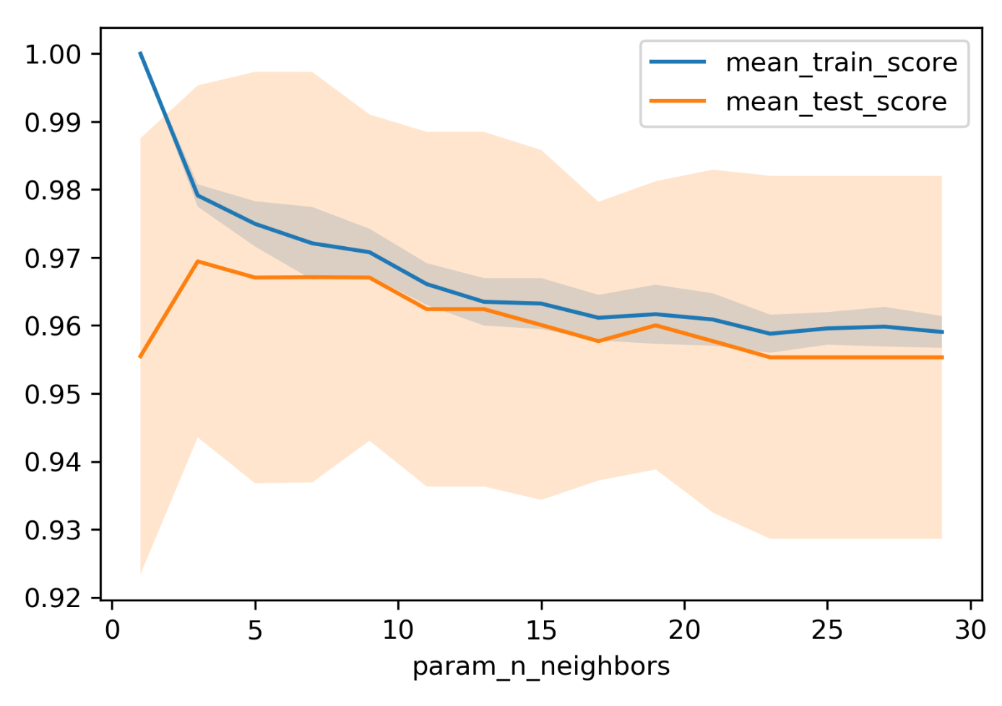
n_neighbors Search Results

Slide 28
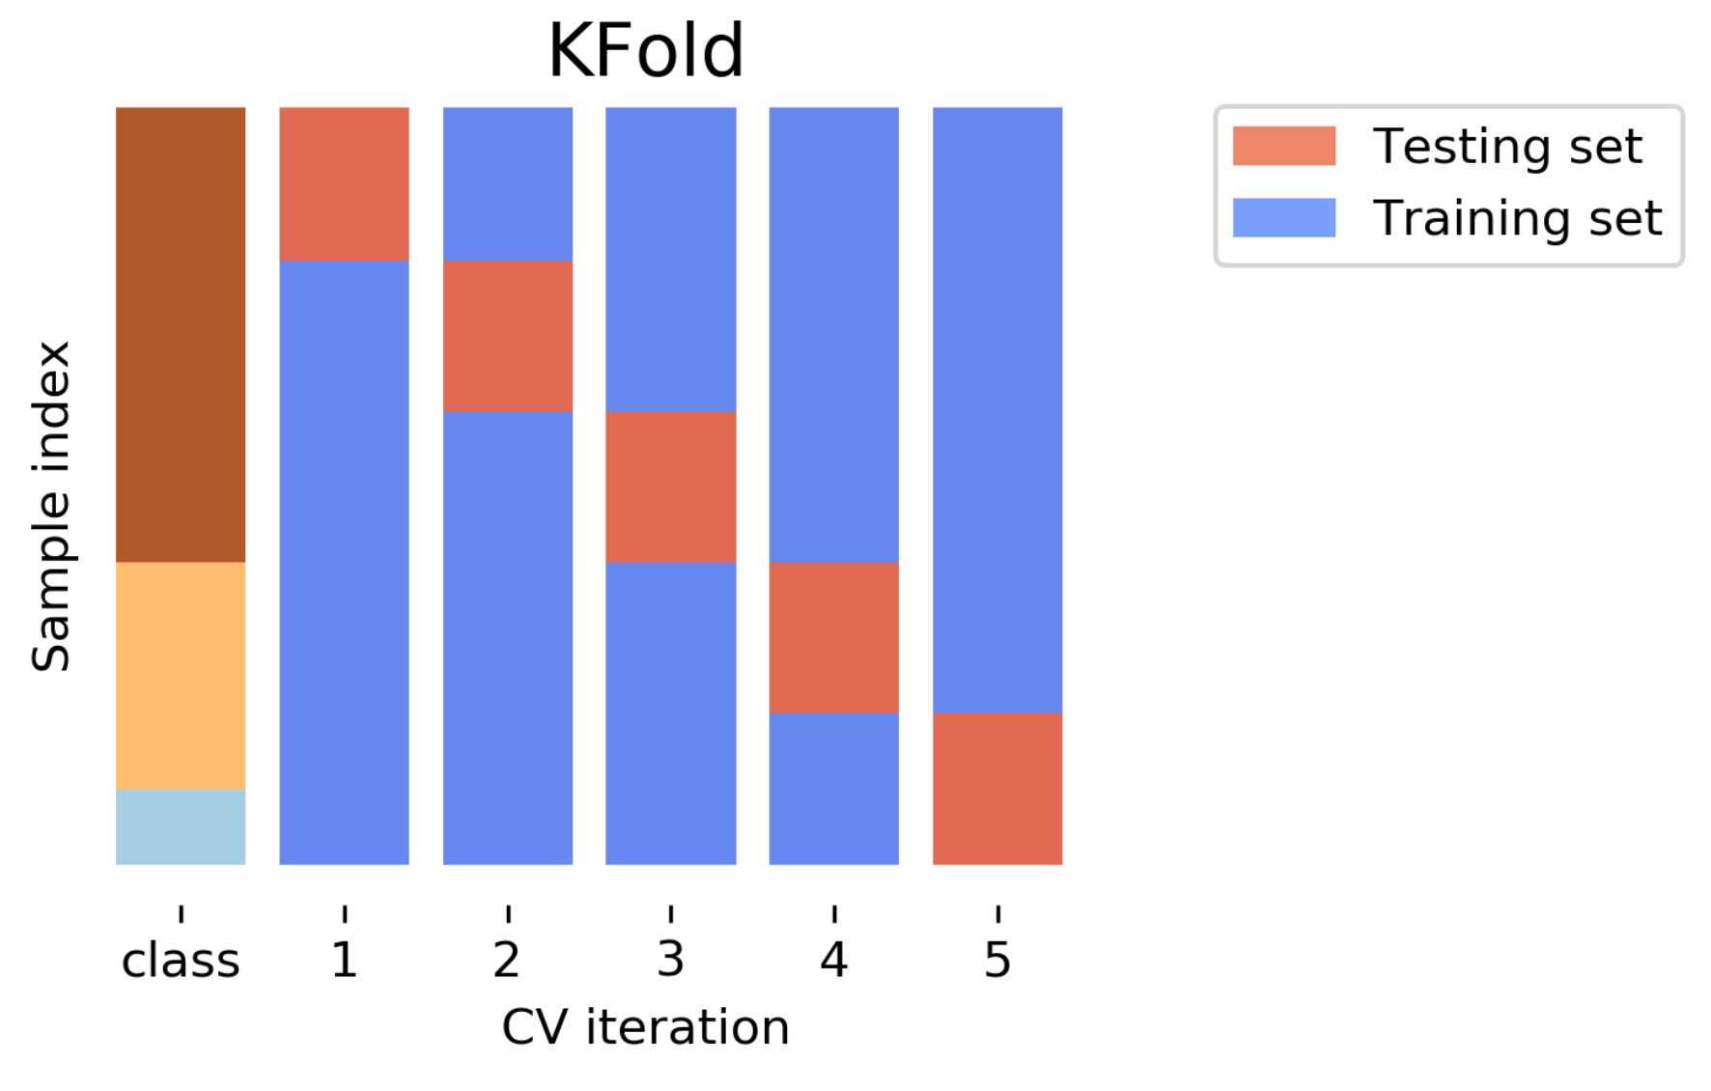
Cross-Validation Strategies

Slide 29
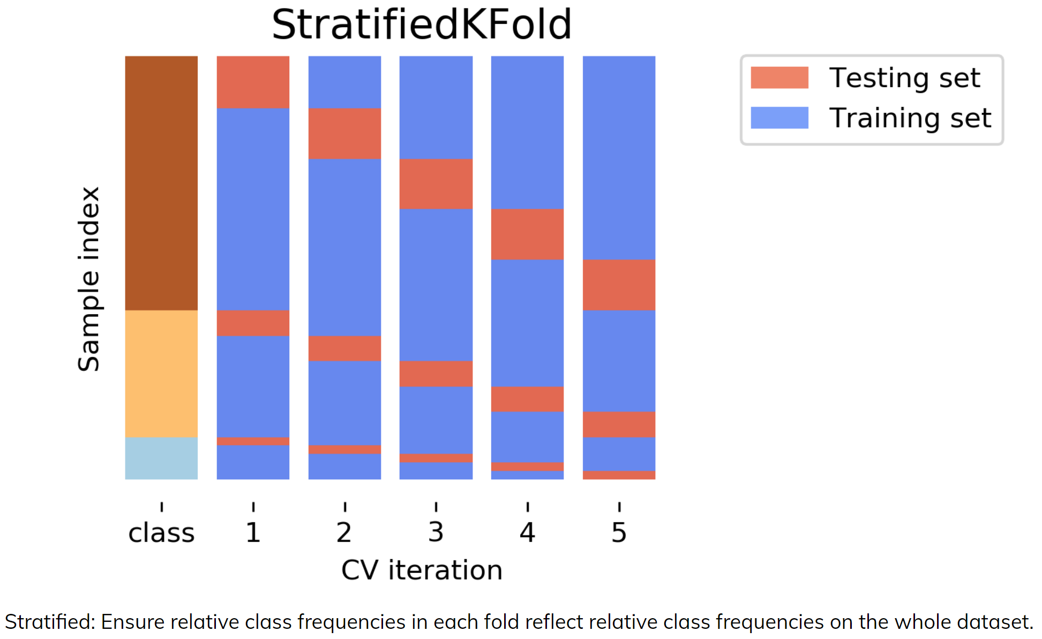
Cross-Validation Strategies

Slide 30
Repeated KFold and LeaveOneOut
LeaveOneOut : KFold(n_folds=n_samples) High variance, takes a long time (see Raschka for a review and Varoquaux for empirical evaluation)
Better: ShuffleSplit (aka Monte Carlo) Repeatedly sample a test set with replacement
Even Better: RepeatedKFold. Apply KFold or StratifiedKFold multiple times with shuffled data.

Slide 31
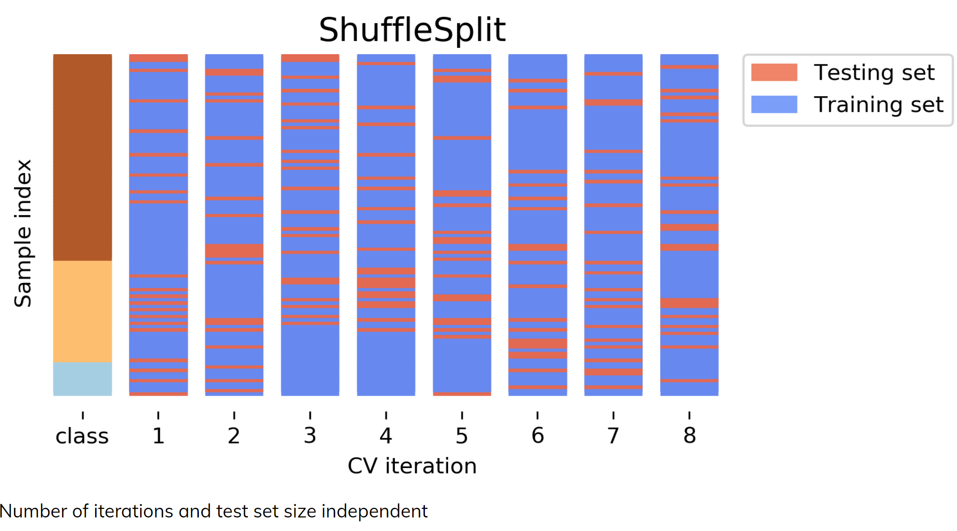

Slide 32
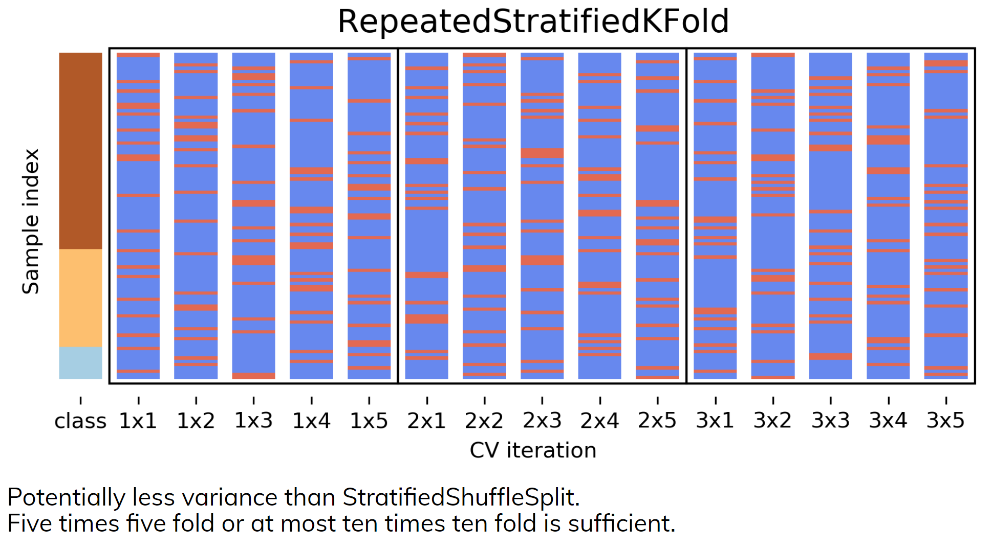

Slide 33
Defaults in scikit-learn
5-fold in 0.22 (used to be 3 fold)
For classification cross-validation is stratified
train_test_split has stratify option: train_test_split(X, y, stratify=y)
No shuffle by default!

Slide 34
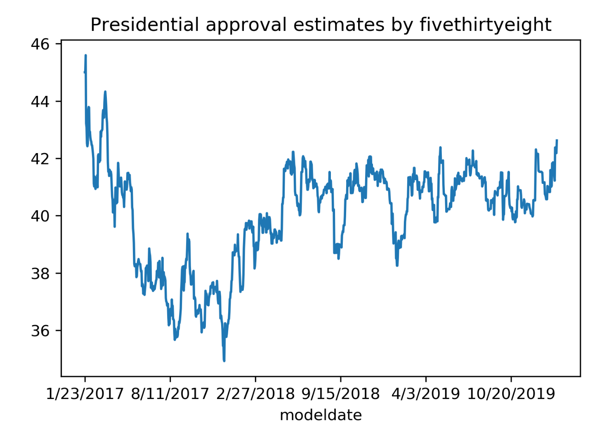
Cross-Validation with non-iid data

Slide 35
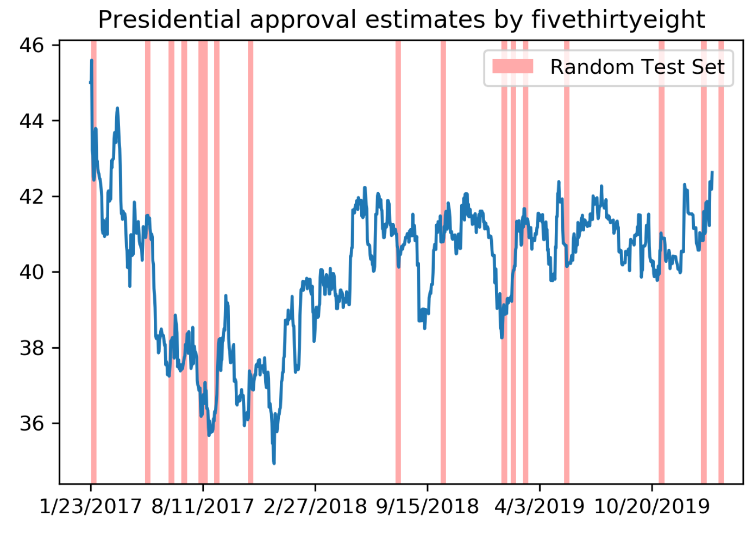

Slide 36
